Slide 1
Craft of Data Visualization
Visualization for Machine Learning models
Alexey Zaytsev,
Skoltech, CDISE
16 January

Slide 2
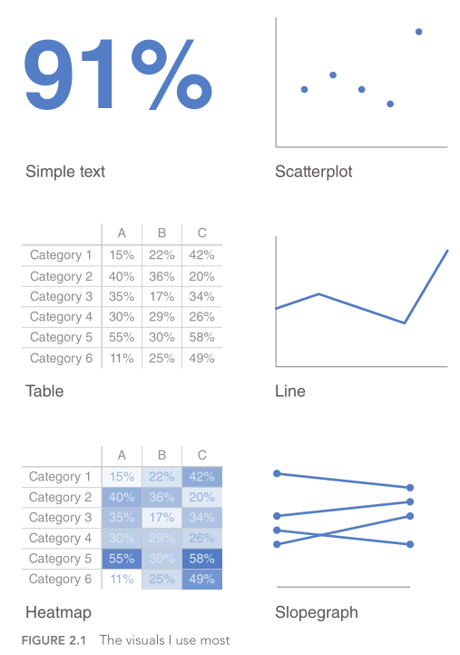
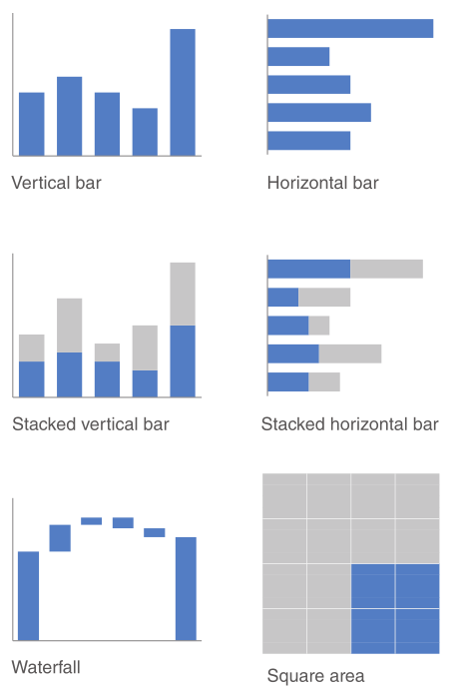
There is a lot of basic plots
Knaflic, C.N. Storytelling with data: A data visualization guide for business professionals. John Wiley & Sons, 2015

Slide 3
We need specific plot for particular application areas They are just basic plots, but with specific curves or points displayed We consider machine learning as an example
Notes:
Specific language in each area: how we say about something and how we tell stories

Slide 4
Main problem statements in Machine Learning
Regression
Classification
Clustering
Dimension reduction

Slide 5
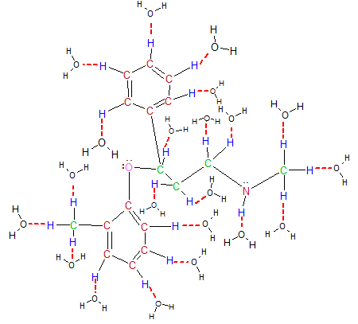

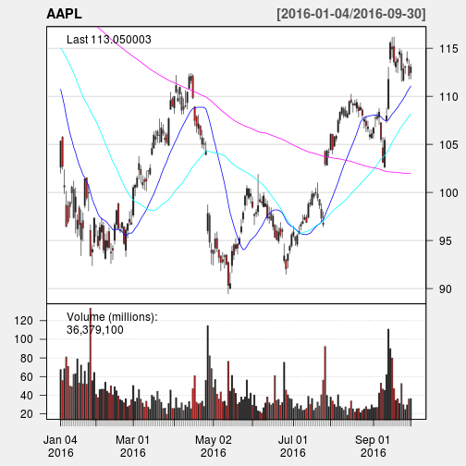
For regression target is continuous
We want to predict the target continuous value
Examples:
Predict solubility of a molecule
Predict price of a house
Predict performance of a portfolio

Slide 6
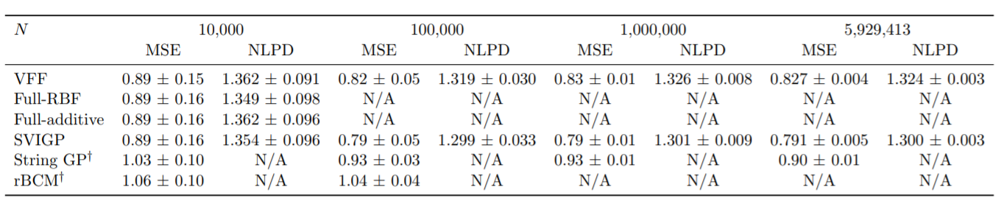
Simplest way: measure errors for different approach and get table
Hensman, James, Nicolas Durrande, and Arno Solin. "Variational Fourier features for Gaussian processes." Journal of Machine Learning Research 18, no. 151 (2018): 1-52.

Slide 7
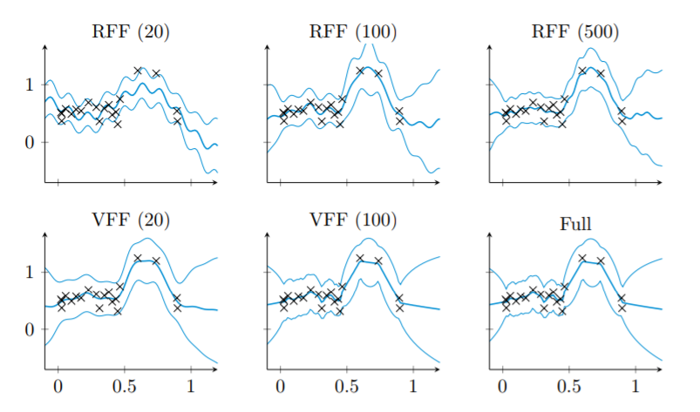
Another simple way is to plot the model itself
Hensman, James, Nicolas Durrande, and Arno Solin. "Variational Fourier features for Gaussian processes." Journal of Machine Learning Research 18, no. 151 (2018): 1-52.

Slide 8
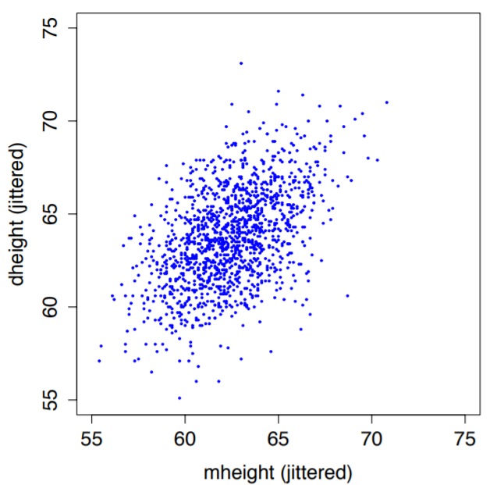
Scatter plot
http://staff.washington.edu/dbp/s423/PDFs/01-chapter-ALR-for-printing.pdf

Slide 9
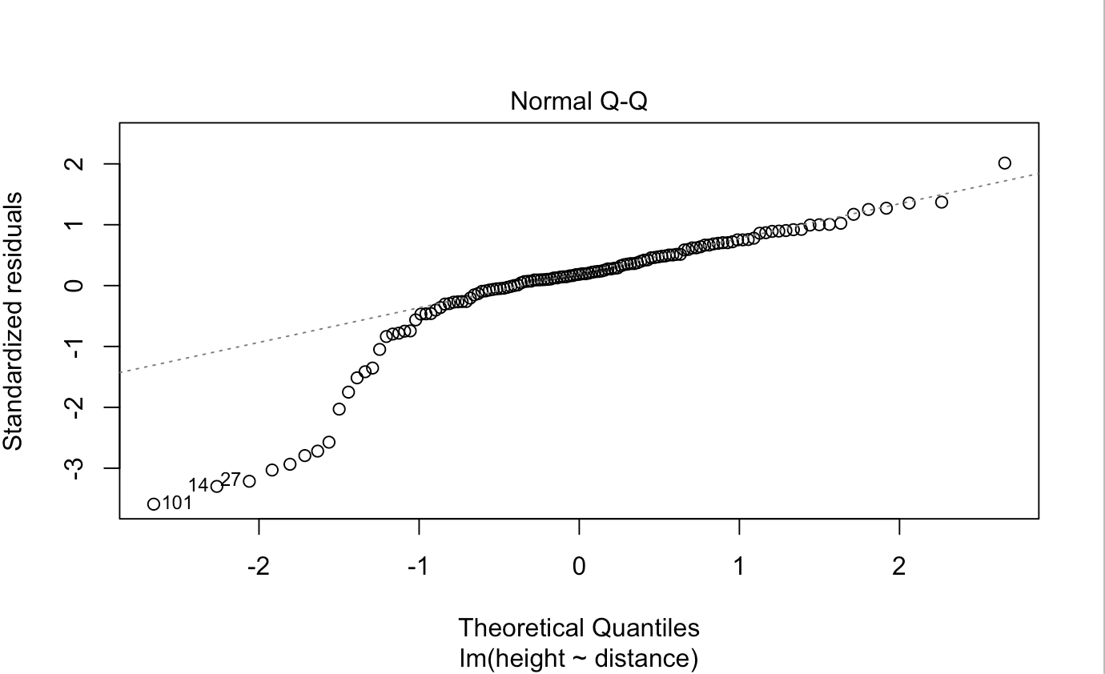
QQ plot
https://stats.stackexchange.com/questions/253916/what-does-this-q-q-plot-indicate-about-my-data

Slide 10
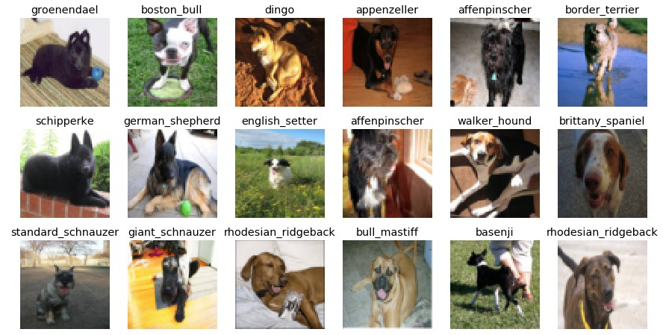
For classification target is discrete
We want to predict the target class of an object
Examples:
Is the molecule a good drug?
Will the customer pay a mortgage?
What dog breed is at the figure?

Slide 11
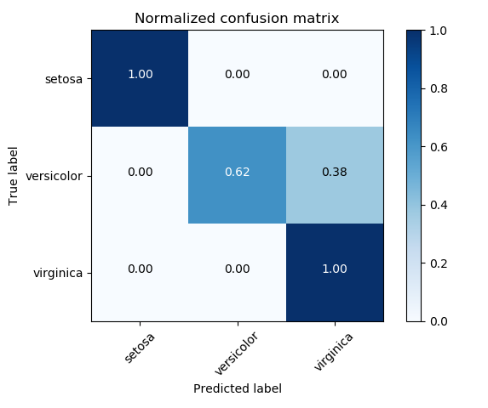
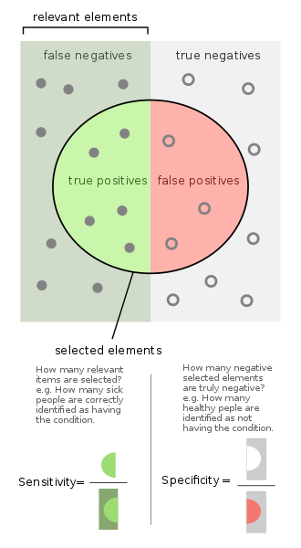
Simplest way: calculate errors
https://scikit-learn.org/stable/auto_examples/model_selection/plot_confusion_matrix.html
https://en.wikipedia.org/wiki/File:Sensitivity_and_specificity.svg

Slide 12
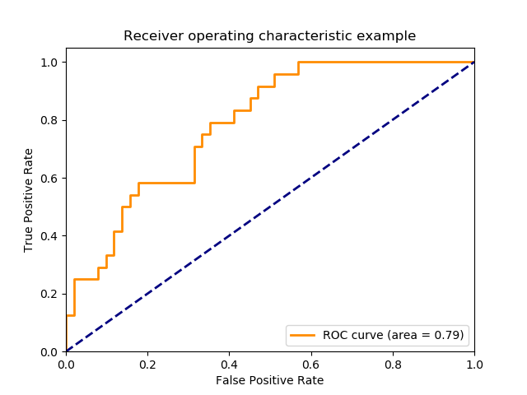
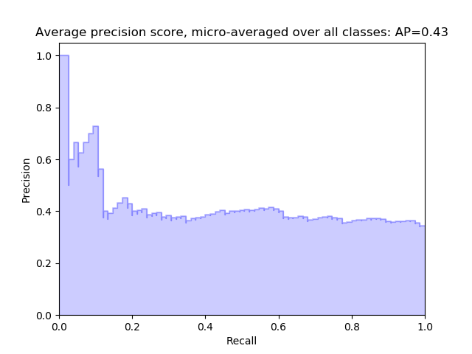
Simplest way: ROC & Precision Recall curves

Slide 13
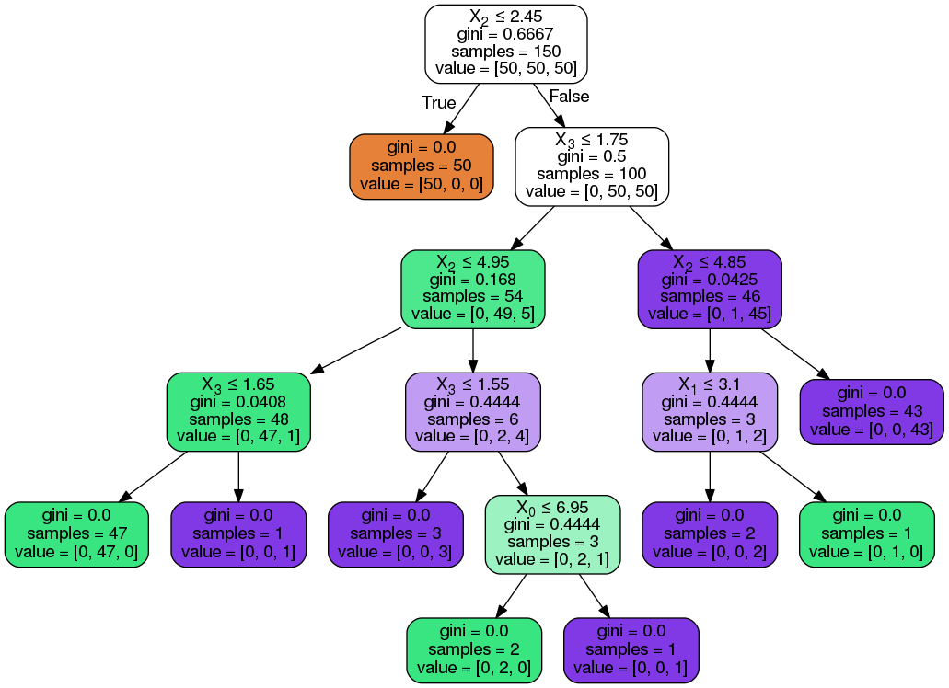
Visualize the model: decision tree
https://medium.com/@rnbrown/creating-and-visualizing-decision-trees-with-python-f8e8fa394176

Slide 14
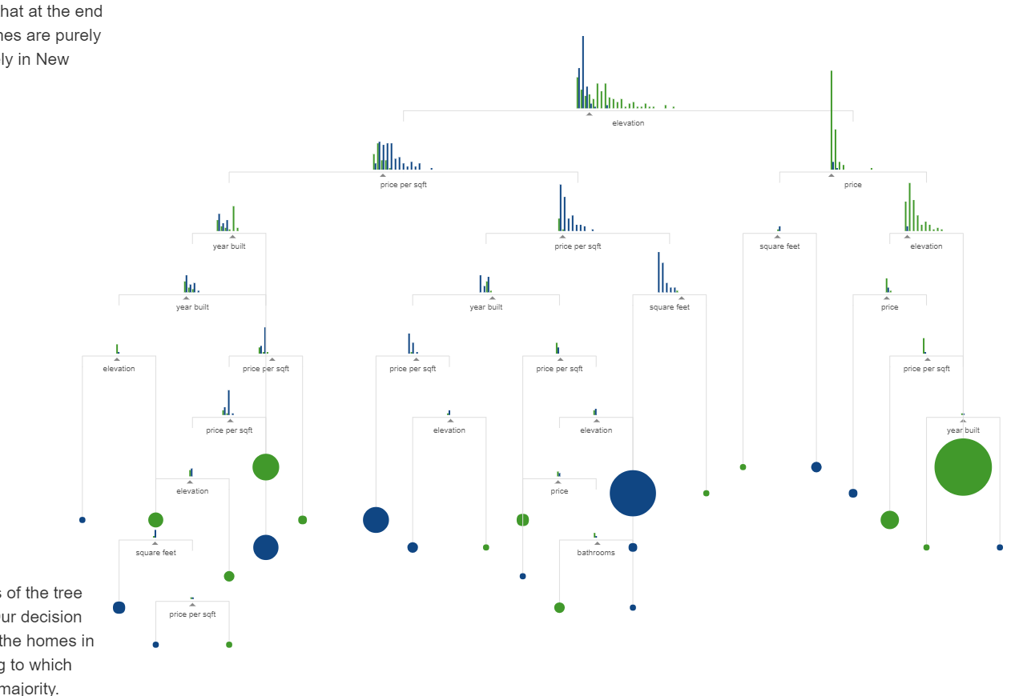
Visualize the model: decision tree
http://www.r2d3.us/visual-intro-to-machine-learning-part-1/

Slide 15
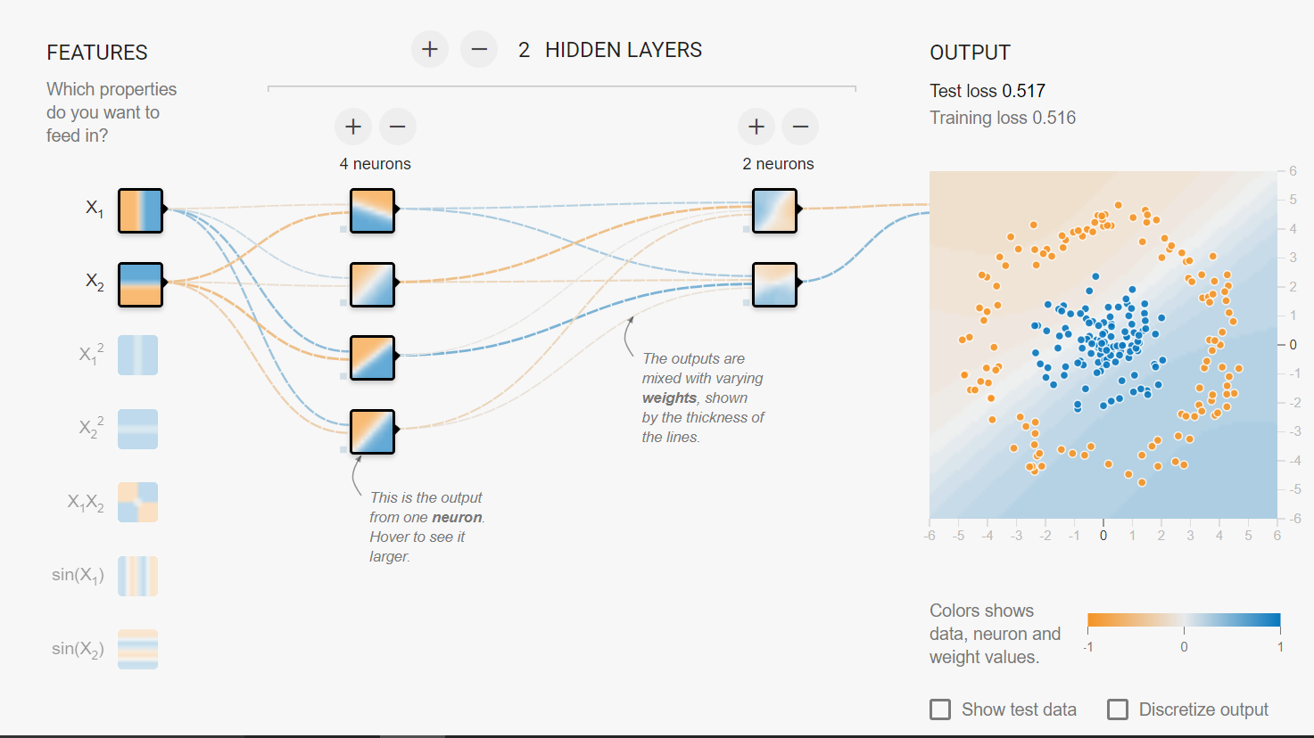
Visualize the model: Neural Network
https://playground.tensorflow.org/

Slide 16
Visualize the model: Neural Network with Tensorboard
https://www.tensorflow.org/guide/graph_viz

Slide 17
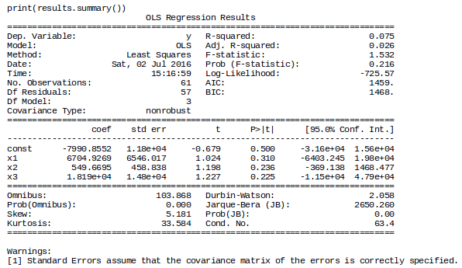
Linear regression
http://www.michaeljgrogan.com/statsmodels-sklearn-linear-regression/ols-regression-results/

Slide 18
Summary
If you are into Machine learning there are specific plots
For regression it is scatter plot or box plot for cross-validation runs
For classification there are ROC and PR AUC curves
There a lot of ways to visualize your machine learning models
Decision trees
Neural networks
Linear regression
…

